Slide 1
Business Intelligence Group Project-1 Sales study of a Canadian eCommerce company By Parijat Kannapan Vivek Sadman

Slide 2
Objective
Data Cleaning
Data Consolidation
Analysis
Recommendation

Slide 3
Data Cleaning and Consolidation
Order ID | Status | Order Date | Order Quantity | Sales | Profit | Calculated Profit | Shipping Cost | Ship Date | Days to deliver
3 | 0 | 10/13/2010 | 6 | 261.54 | -213.25 | -213.25 | 35 | 10/20/2010 | 7
6 | 0 | 2/20/2012 | 2 | 6.93 | -4.64 | -4.64 | 2.56 | 2/21/2012 | 1
32 | 0 | 7/15/2011 | 15 | 140.56 | -128.38 | -128.38 | 8.99 | 7/16/2011 | 1
32 | 0 | 7/15/2011 | 26 | 2808.08 | 1054.82 | 1054.82 | 5.81 | 7/17/2011 | 2
32 | 0 | 7/15/2011 | 24 | 1761.4 | -1748.56 | -1748.56 | 89.3 | 7/16/2011 | 1
32 | 0 | 7/15/2011 | 23 | 160.2335 | -85.13 | -85.13 | 5.03 | 7/17/2011 | 2
35 | 0 | 10/22/2011 | 30 | 288.56 | 60.72 | 60.72 | 2.25 | 10/23/2011 | 1
35 | 0 | 10/22/2011 | 14 | 1892.848 | 48.99 | 48.99 | 8.99 | 10/24/2011 | 2
1699 | 0 | 12/29/2010 | 40 | 430.88 | 39.00 | 39.00 | 5.25 | 3/23/2011 | 84
56740 | 0 | 10/16/2012 | 33 | 662.21 | 256.57 | 256.57 | 3.62 | 10/23/2012 | 7
66 | 0 | 1/19/2009 | 41 | 108.15 | 7.57 | 7.57 | 0.7 | 1/19/2009 | 0
69 | 1 | 6/3/2009 | 42 | 1186.06 | 511.69 | -7.84 | 3.92 | 6/5/2009 | 2
69 | 1 | 6/3/2009 | 28 | 51.53 | 0.35 | -1.40 | 0.7 | 6/5/2009 | 2

Slide 4
In the excel datasheet, we have created a new column called calculated profits, so that profits don’t get added when an item is returned. Similarly to find the products that are returned, a separate column Status has been added. In addition, number of days to deliver is also added to check the estimated delivery time for each product. In this way, data is cleaned and scaled to start analysis on it.

Slide 5
Analysis> KPI : 2009-2012

Slide 6
The first bar graph shows a comparison of profits and sales together over the years from 2009 to 2012 in the descending order of Sales.
The second Bar graph shows the descending of profits over the years where 2012 being the lowest.

Slide 7
KPI : 2009-2012

Slide 8
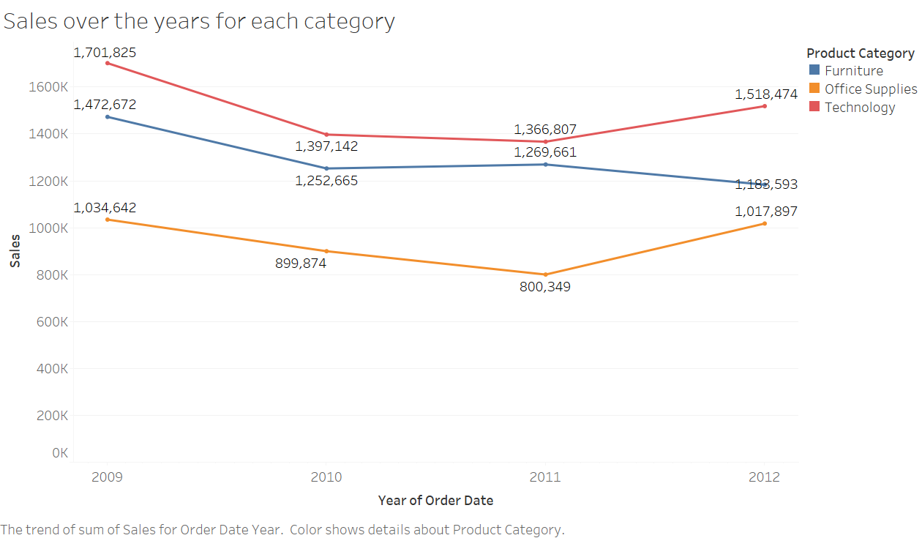
KPI <Categories>: 2009-2012
Category | Sales | Profit
Technology | 40.12% | 60.10%
Furniture | 34.72% | 8.41%
Office Supplies | 25.16% | 31.49%
Grand Total | 100.00% | 100.00%

Slide 9
In this dashboard, we could find that the profits follows the trend of furniture. Hence furniture is the decider of the profit zone for the company. But it is contributing to just about 8% of the total profit of the company.
On the other hand technologies and office supplies are profitable with 60% and 32% respectively.

Slide 10
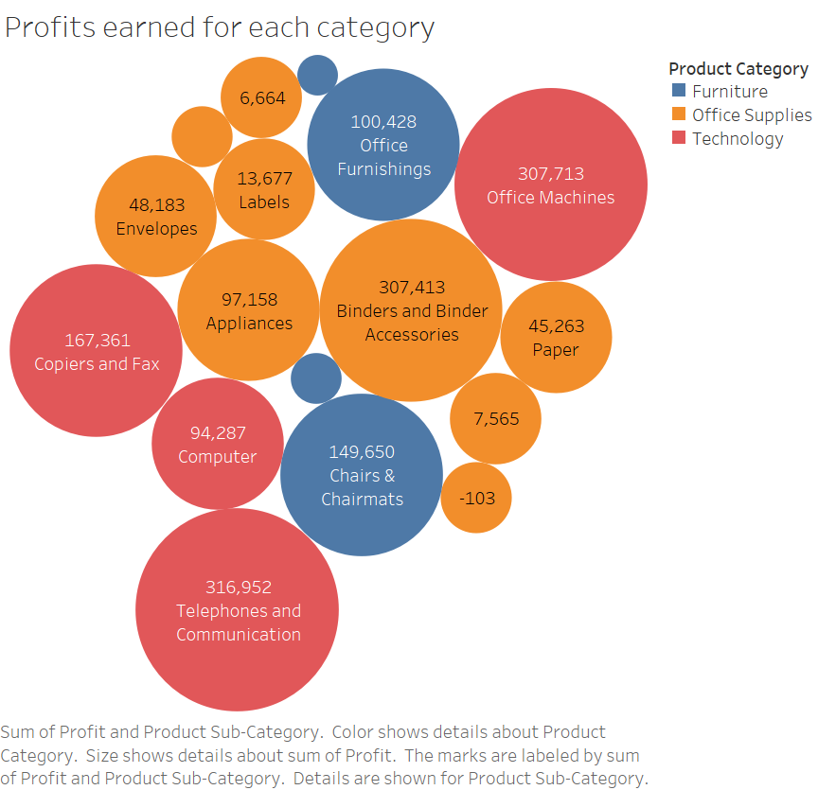
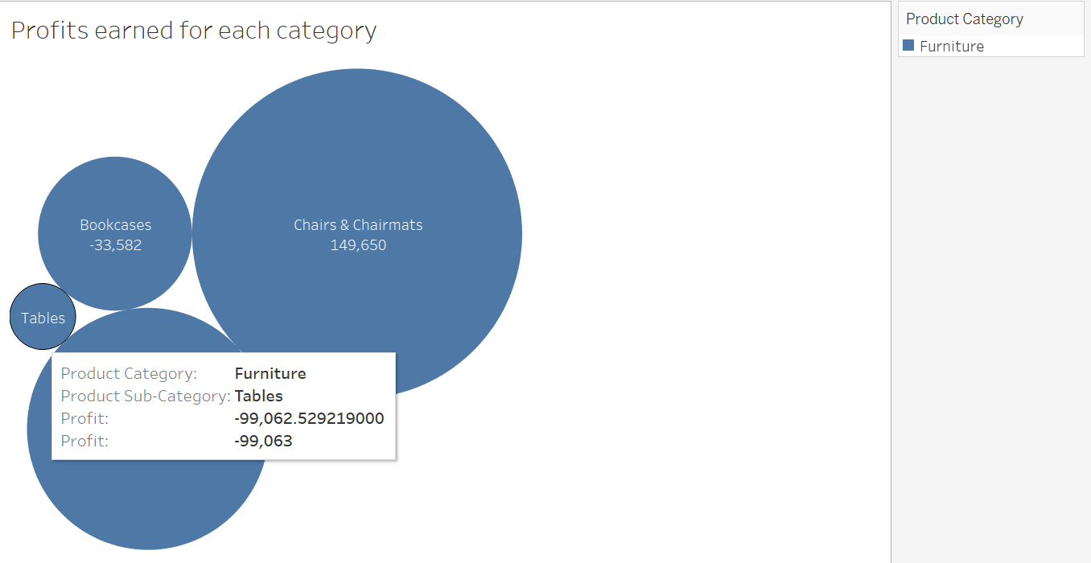
KPI <Categories>: 2009-2012
Category | Sales | Profit
Technology | 40.12% | 60.10%
Furniture | 34.72% | 8.41%
Office Supplies | 25.16% | 31.49%
Grand Total | 100.00% | 100.00%

Slide 11
This Bubble map shows the two furnitures which gave the highest losses with Tables giving the loss of 99000$ and bookcases giving a loss of 34000$. While the other furnitures like chairs and chairmats are doing a good job.

Slide 12
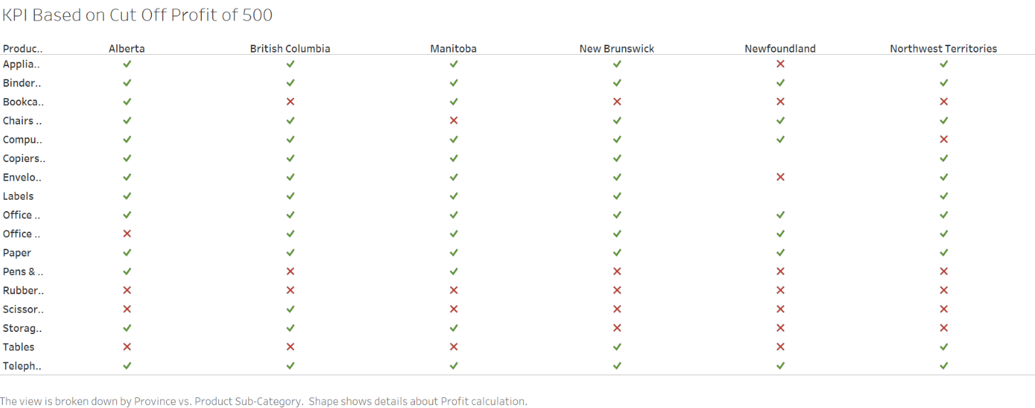
KPI : 2009-2012

Slide 13
Our KPI over here are the profits, since it determines whether to continue the supply of a particular product across provinces.
So by having Profits as KPI, we have obtained the above table. So it portrays the regions where tables and bookcases are getting losses. Both of them are incurring losses in every provinces except two.

Slide 14
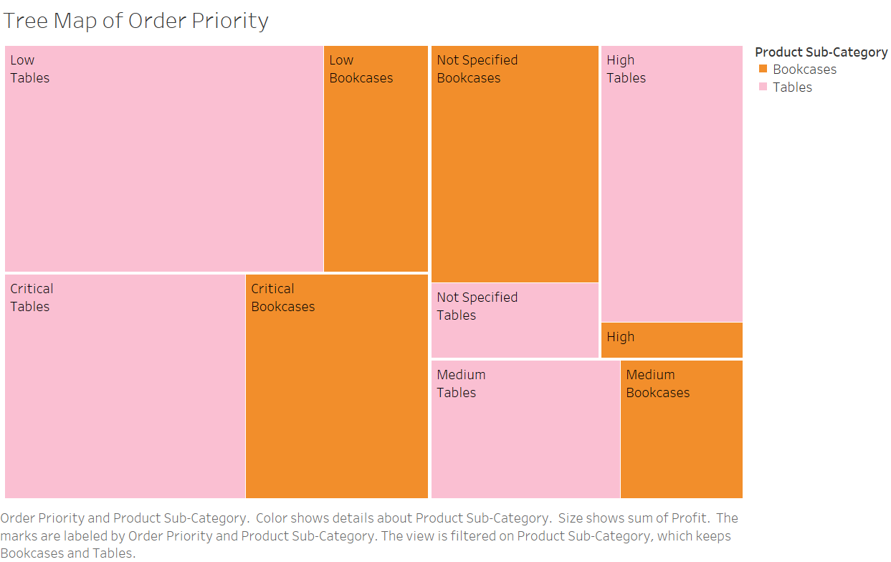
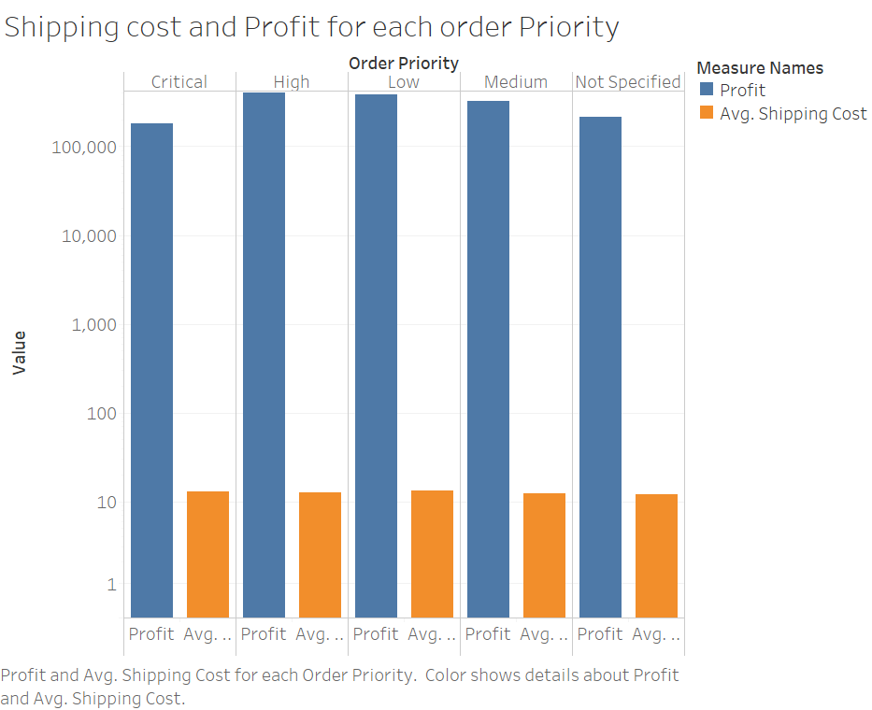
Why Bookcase and Tables are making Losses?

Slide 15
In this tree map, the order priority of tables and bookcases are plotted. And the shipping cost bar graph is plotted.
So we can understand that there are high products which are critical and still the shipping cost remains the same for every order priorities. In this case, we can increase the shipping cost by 15$ for tables, so that the losses can be neutralized. But even by doing that, its not possible to neutralize the losses for bookcases.

Slide 16
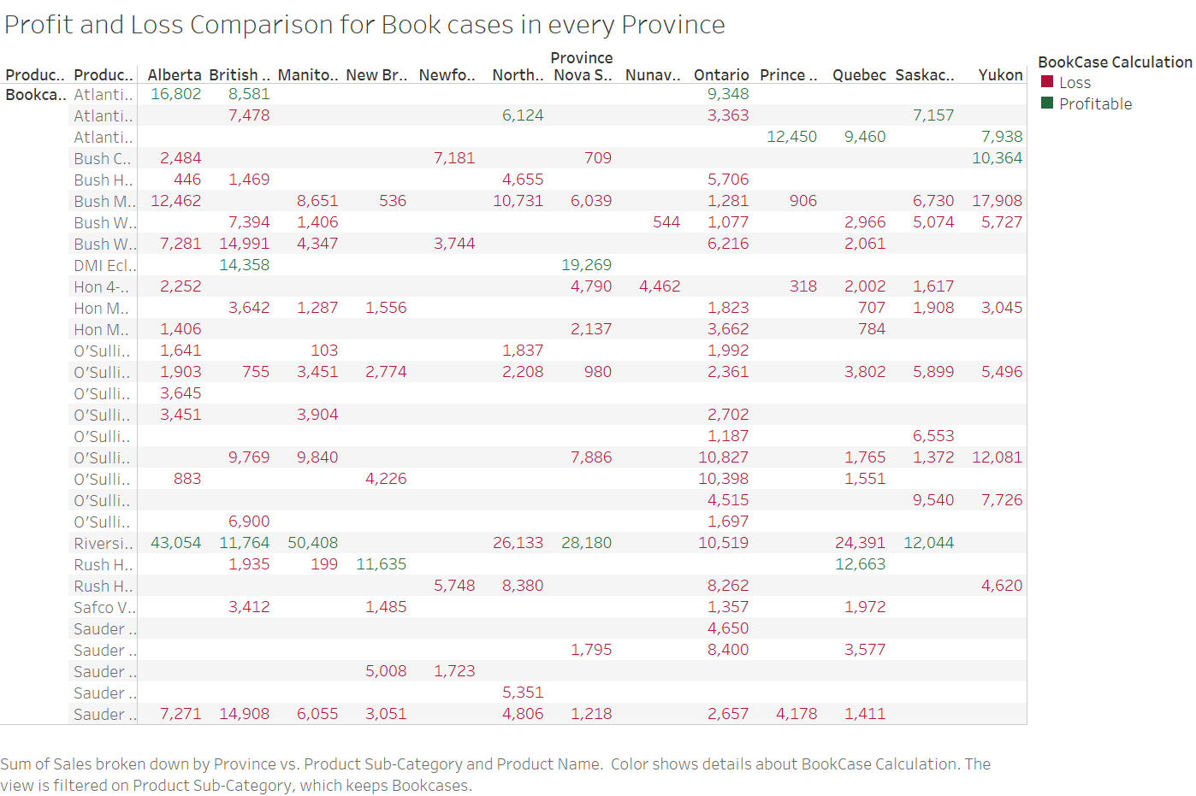
Recommendation for Bookcase
Cutoff Profit: $1000
Recommendations:
Royal Cherry Finish($881)
Atlantic($241)

Slide 17
With our KPI being profits, we drilled down even further plotting a separate sheet for Bookcases across different provinces with profit cutoff of 1000$.
Now it is clearly understood that most of the Bookcases are incurring losses across all provinces. Whereas some Bookcases like Royal cherry finish and Atlantic are doing wonders.

Slide 18
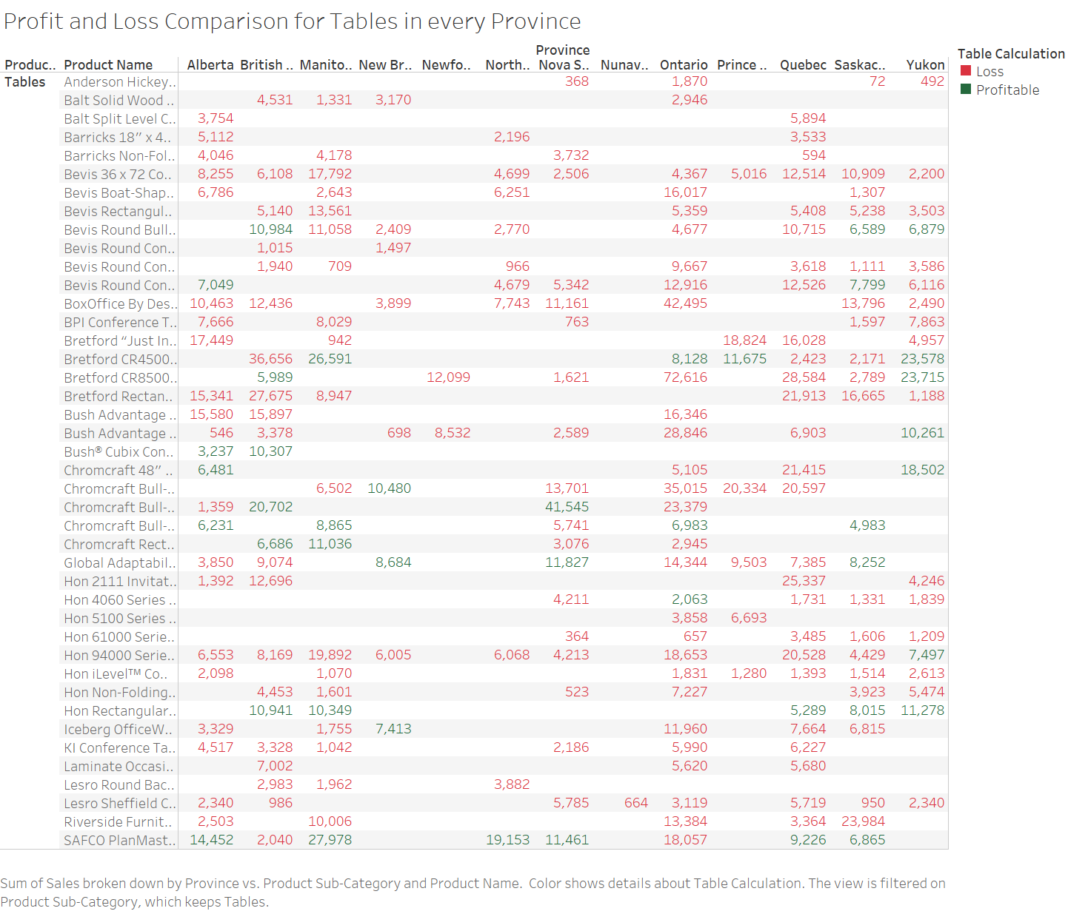
Recommendation for Tables
Cutoff Profit: $500
Recommendations:
Bredfort CR4500
Bush Cubis and Wood base
Saffco

Slide 19
With our KPI being profits, we drilled down even further plotting a separate sheet for Tables across different provinces with profit cutoff of 500$.
It is visible that most of the Tables are incurring losses across all provinces. Whereas some tables like Bredfort CR4500 and SAPCO are doing great.

Slide 20
Customer Retention: Customer Type and Location
Province/Region | Sales
Ontario | 20.54%
Ontario | 20.54%
British Columbia | 12.69%
West | 12.69%
Alberta | 11.43%
West | 11.43%
Quebec | 10.12%
Quebec | 10.12%
Saskachewan | 9.82%
Prarie | 9.82%
Manitoba | 9.20%
Prarie | 9.20%
Yukon | 6.54%
Yukon | 6.54%
Nova Scotia | 5.48%
Atlantic | 5.48%
Northwest Territories | 5.37%
Northwest Territories | 5.37%
New Brunswick | 4.59%
Type of Customer | Sales
Corporate | 36.87%
Home Office | 23.90%
Consumer | 20.54%
Small Business | 18.69%
Grand Total | 100.00%
Customer | Sales
Ontario | 20.54%
Alejandro Grove | 0.56%
Consumer | 0.19%
Corporate | 0.37%
John Lucas | 0.53%
Corporate | 0.05%
Small Business | 0.48%
Philip Brown | 0.41%
Corporate | 0.24%
Home Office | 0.17%
Ritsa Hightower | 0.37%
Corporate | 0.37%
Edward Nazzal | 0.37%
Home Office | 0.27%
Small Business | 0.10%
Lena Creighton | 0.32%
Corporate | 0.02%
Home Office | 0.30%
Darren Budd | 0.32%
Consumer | 0.18%
Corporate | 0.12%
Home Office | 0.02%
Victoria Wilson | 0.29%
Home Office | 0.29%
Lycoris Saunders | 0.26%
Corporate | 0.24%
Home Office | 0.01%
Pauline Chand | 0.26%
Corporate | 0.11%
Small Business | 0.15%

Slide 21
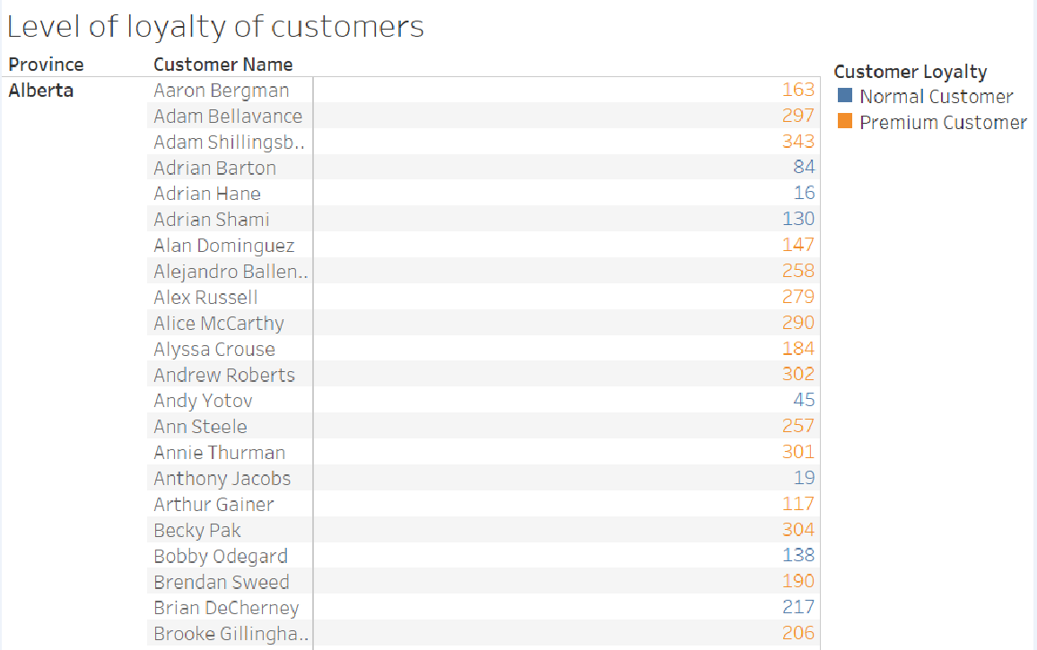
Customer Retention: Customer Type and Location
Cutoff profit: $5000
Cutoff Order Qty: 100

Slide 22
With our KPI being profits, we drilled down even further plotting a separate sheet for customers across different provinces with profit cutoff of 5000$ and order quantity of 100.
Based on this premium customers and Normal customers are found.

Slide 23
Customer Retention: Shipping Delay negation
Order Priority | Max no of Days to deliver | Average Days to deliver | Average Order Quantity
Critical | 84 | 2 | 25
Delivery Truck | 5 | 1 | 25
Express Air | 3 | 1 | 25
Regular Air | 84 | 2 | 26
High | 3 | 1 | 26
Delivery Truck | 3 | 1 | 25
Express Air | 3 | 1 | 25
Regular Air | 3 | 1 | 26
Low | 92 | 4 | 26
Delivery Truck | 9 | 4 | 27
Express Air | 19 | 4 | 27
Regular Air | 92 | 4 | 26
Medium | 19 | 1 | 25
Delivery Truck | 17 | 2 | 25
Express Air | 18 | 1 | 25
Regular Air | 19 | 1 | 25
Grand Total | 92 | 2 | 26

Slide 24
Discount Analysis

Slide 25
Discount Analysis
Recommendation
Furniture>>
Office Furnishings>
DAX Wood Document Frame.
GE 4 Foot Flourescent Tube, 40 Watt
Nu-Dell Executive Frame
Tensor Computer Mounted Lamp
Tables>
Lesro Sheffield Collection Coffee Table, End Table, Center Table, Corner Table

Slide 26
Even with low discounts or high discounts, the technology and office supplies are being profitable, but on the other side, the furnitures are facing trouble even with high discounts.

Slide 27
SWOT Analysis
Strengths | Weaknesses
Technology and office supplies are already highly profitable. | Furnitures on the whole contribute only to about 8% of the total profit.
Chairs and chair mats are neutralising the losses provided by the tables. | Among the furniture , table causes around 99000 dollars of losses.
Opportunities | Threats
By cancelling some contracts with the table and bookcase suppliers we can reduce the losses to huge extent and save lot of space at particular warehouse. | In the virtue of removing some contracts with table suppliers, we may lose some of their other products like chairs .This may incur some losses.
We can increase the shipping cost for the critically prioritized tables. | If we keep on adding the items to the warehouse without getting them sold then it not only consumes spaces at warehouse but gets old fashioned and in turn the resale value also falls down.

Slide 28
RECOMMENDATION
The tables and bookcases which are consuming more spaces and are not profitable can be sold out on clearance sale to the premium customers and corporate sectors.
The contract for the particular tables and bookcases can be cancelled.
Royal cherry finish supplies can be increased across Ontario and Atlantic supplies can be increased across other small provinces.
Shipping cost can be raised by 15$ for the critical products and hence shipping delays should also be reduced.

Slide 29
Thank You

